Slide 1
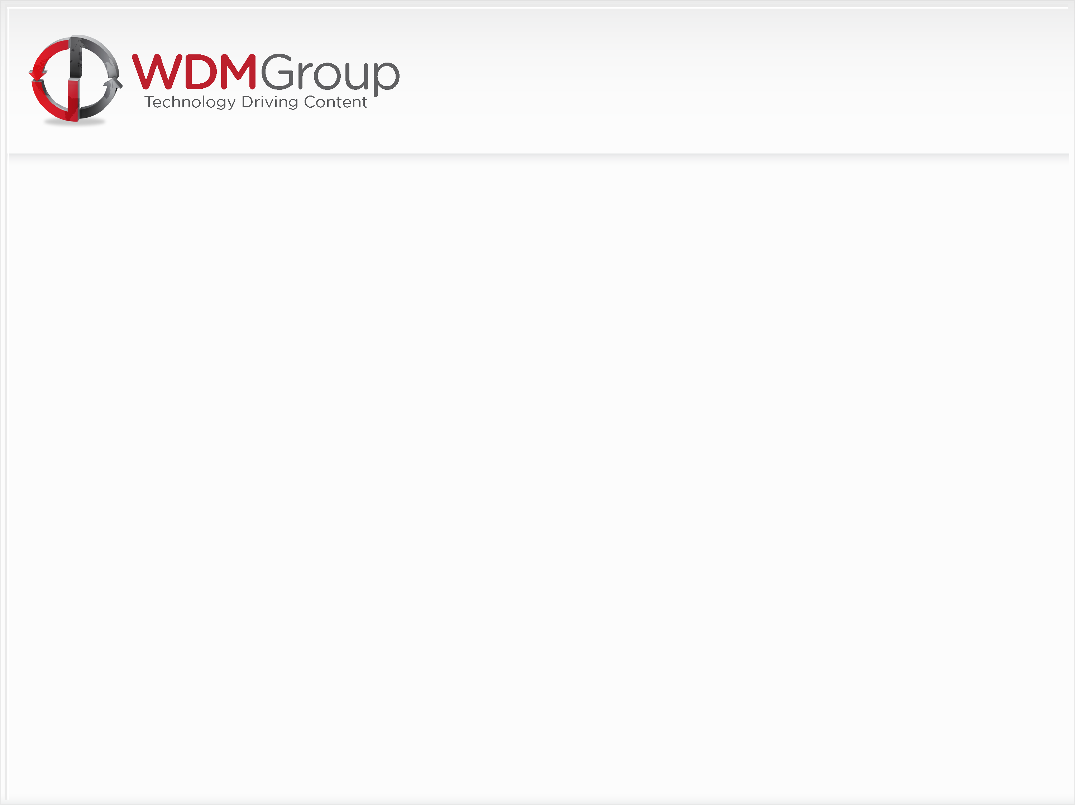
Welcome To WDM Group
Training Induction for Research & Project Directors

Slide 2

Personal Background
WDM Group
Introductions

Slide 3
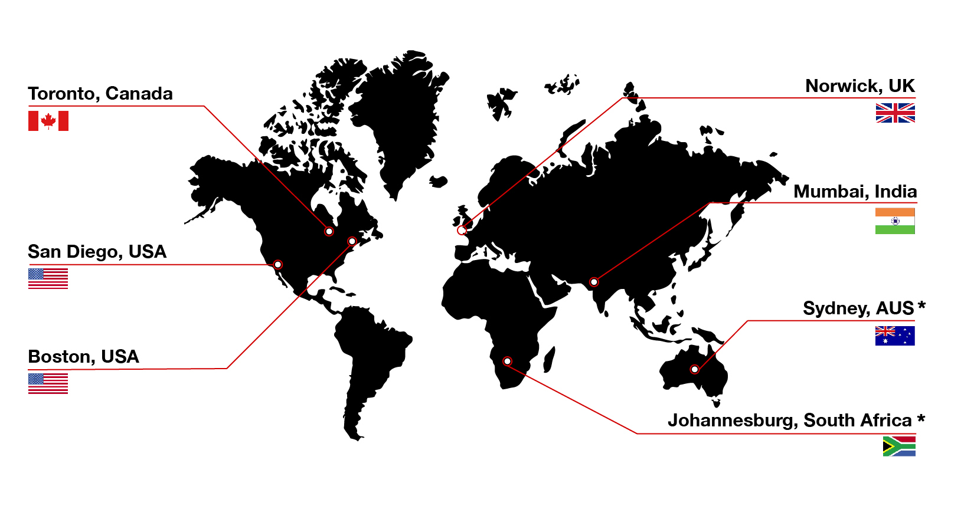
Who Are We?

Slide 4

What To Expect?
Today:
What Do We Do?
How Do We Do It?
- The Theory
- Call Process
- KPI’s
Tomorrow:
Listen & Learn
Lead Generation/Begin Preparation
Day 3:
Get on the phones!

Slide 5



Brand Structure & Product Portfolio
Business Review
Industry Channel
Digital Media Marketing

Slide 6

What Do We Do?

Slide 7
Profiles Business Model
Revenue Generation through a ‘Vendor Model’
“Sales By Association”
Client Relationships
Supplier Partnerships
Contract Wins & Tendors
Investments & Awards
Business Partnerships
As Simple As - “Company ‘A’ supports Company ‘B”

Slide 8
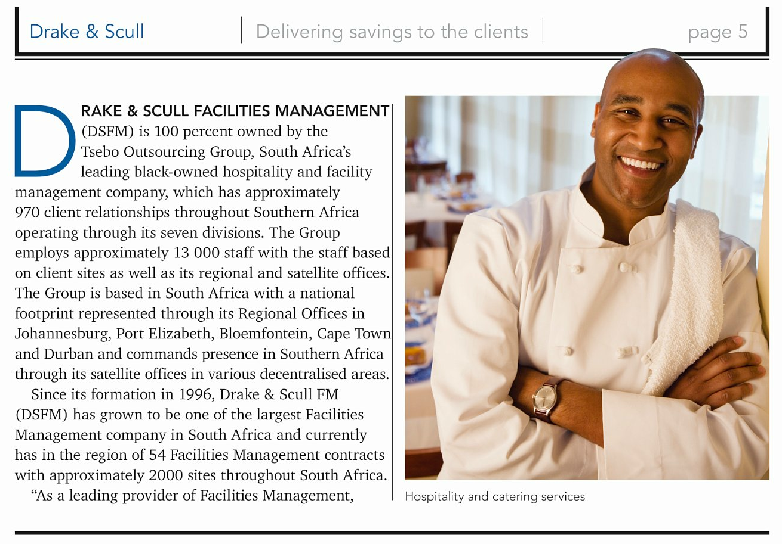
Profiles Business Model
Examples

Slide 9
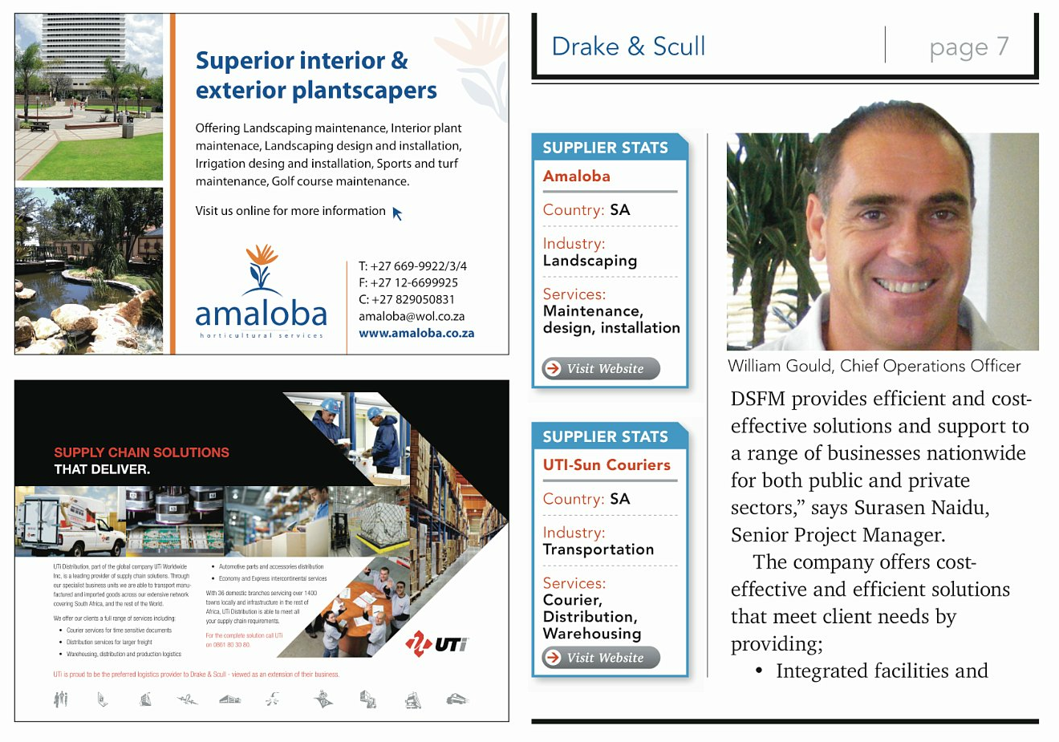
Profiles Business Model

Slide 10
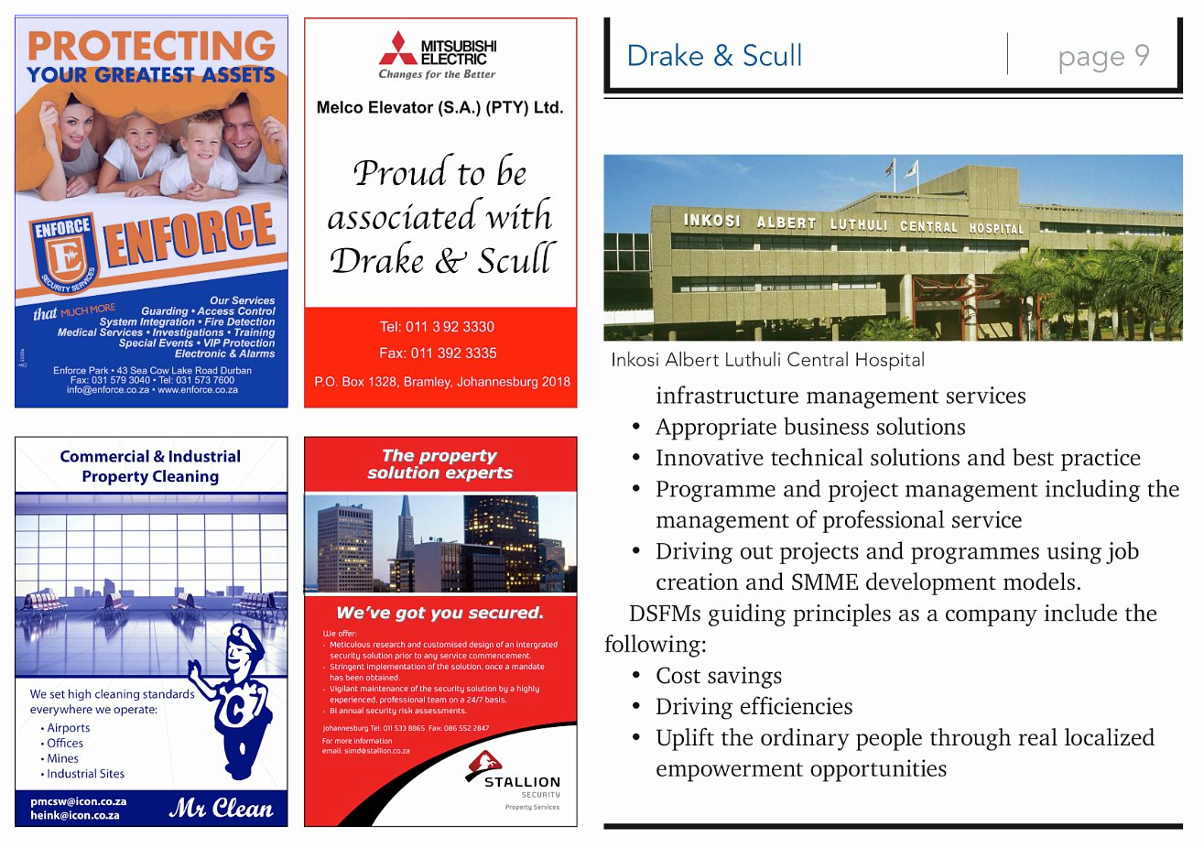
Profiles Business Model

Slide 11
How Do We Do It?

Slide 12
The Secret to Success
Without strong Research and Marketing, the entire call centre process is diluted expedentially and will generally be the contributing factor in not converting at the standard 4:2:1 and achieving revenue generation expectations. The very basis of poor LHA’s will damage your ability to achieve activity and input targets and will lead to a significant reduction in your ability to hit and make strong commission – you get OUT what you put IN!!
Glen White, Chairman & Founder

Slide 13
Leads, Hooks & Angles
Leads
A sales lead is a Company, Business or Individual potentially interested in or suitable for a profile.
Hooks
A conversational common ground between you and your sales lead that allows you to introduce your project. Examples of this are Associations, Federations, Trade Shows and Exhibitions.
Angles
Points of interest or ‘Hot Topics’ that make your sales lead ‘bite’ and show significant interest in your proposal.

Slide 14
Research & Marketing (LHA’s)
Leads
Capture and manage your Leads on the company standard Lead Spreadsheet. Use this to create a detailed account of every lead and their contact details. Each week you will be asked to email this back to us in order that we can capture the information for our Group database so make sure you fill in as much information as possible.
Hooks
Confidence in your ‘Hook’ is essential for a strong Suspect introduction. Make sure you have the authority of the Association/Expo before you start calling your Leads. A personally written ‘Foreword’ or official Event press release is the key to gaining traction with your industry leaders.
Angles
Hot topics, points of interest, latest news or industry investments and developments that allow you to talk confidently and intelligently on your industry. Angles give you the credibility you need to engage the industry leaders in conversation and begin building the relationship required to complete the process.

Slide 15
The Secret to Success
LHA’s + Activity = Results

Slide 16
Activity & Input Targets
Daily Activity:
4 Sessions
3 Hours
100 Calls
Weekly Input:
8 Suspects
4 Prospects
2 Approvals
Monthly Revenue:
£15,000 / $ 24,000
Session 1: Suspect Frenzy – 40 Calls, 1 Hour and at least 1 Suspect
Session 2: Prospect Follow Up – 25 Calls, 45 Mins, at least 1 Prospect
Session 3: Suspect Frenzy – 40 Calls, 1 Hour and aim for another Suspect!
Session 4: Phone Melt Down! – Whatever you need to do to hit your daily targets – 25 Calls and 30 Mins minimum

Slide 17
10 Point Plan
Leads
Hooks
Angles
Suspect - Introduction
Suspect - Information – Top Floor to Shop Floor
Suspect - Close & Consolidate
Prospect - Reintroduction
Prospect - The Process
Prospect - The Marketing Pitch
Prospect - Supplier Close

Slide 18
Preparation
Understand your Sector/Territory – Spidergram & iGram
Know your Production Schedule
Know your Editorial calendar – “Putting the spotlight on...”
Take an interest in the latest news – Set up Google alerts for one off ‘hot’ leads
Use your own industry website for latest news and ‘hot topics’
3 Month Planners – Require a minimum 6 Associations and/or Exhibitions, Media Partner contact details, 500 + available Leads and 3 Strong Angles per project
Lead Spreadsheet Management – To comply with the company standard spreadsheet and emailed weekly – All relevant/highlighted fields to be complete

Slide 19
Session 1 & 3
Suspect Bonanza!
Lead Spreadsheet, Suspect Pad & Telephone only!
No other distractions!
Know your lines – The ‘Elevator Pitch’!
Dial & Smile – Sound bright and enthusiastic but not scripted!
40 calls and 1 hour of Activity as a minimum requirement.
1 Suspect, hand written, before end of Session 1 – Every morning!
Set personal goals and targets – Don’t be satisfied with less!

Slide 20
Session 2 & 4
Prospects +
Calendar appointments set from previous days Suspects
Follow up/chase any missed appointments or overdue calls – Note: Good buy in at Suspect stage should keep these calls to a minimum.
25 calls and 45 minutes of Activity as a minimum requirement
Make use of every opportunity! – Get back on to Suspects once all Prospects contacted
Turn around P3’s –
Not an ‘open ended’ invitation
Work to deadlines and Editors decision
Find Decision Maker if you have ‘pitched’ the wrong guy!

Slide 21
Suspect (Hand Written)
Engage the decision makers only, not marketing or sales executives
Upbeat introduction full of energy and enthusiasm
Use ‘ice breakers’ and a sense of humor - You are the tour guide to their WDM experience!
Build a personal/professional relationship
Ask intelligent questions and make detailed notes using the TF2SF strategy
Highlight emphasis of editorial meeting in decision making process
Close the suspect with a timeframe commitment for the Prospect
Send Suspect Follow Up email inc. links to suitable examples and the relevant website or magazine along with any testimonials available

Slide 22

The Suspect Call - Introduction
Top Tips…
The ‘Elevator Rule’
20 Seconds to engage your Suspect
Establish relevancy and credibility
The ability to naturally communicate
Disguise your ‘Pitch’ as conversation
Create a relationship
Have confidence in your ‘Hook’
A good ‘Hook’ removes the element of a ‘Cold Call’
Be polite yet respectfully persistent
Deal with objections
Sound like an expert

Slide 23
The Suspect Call - Information
Top Floor to Shop Floor -
Strategic Management –
Understanding the business structure, size, turnover and profitability. The Board and Senior management structure, the forward facing business plan and the companies ‘unique selling points’.
2. Continuous Improvement -
Looking at all aspects of how organisations are driving continuous improvement, lean, kaizen or six sigma techniques through their organisation
3. People Management -
From recruitment, retention and development, this core area explores how organisations deal with people management. people are always crucial to the success of most great companies.

Slide 24
The Suspect Call - Information
4. Supply Chain Management -
Whether organisations are using a total outsourced solution, off-shoring production or back office requirements or simply working with their top ‘business vendors’ to improve pricing and productivity.
Technology –
With the growth of Global economies, it is clear that technology will be a key driver in the future success of most companies. technology enables access to knowledge, data and content and therefore is key to any future business strategy.
6. Operations -
The shop floor is often seen as the ‘engine room’ of any business whether in production, retail, call centres or a service industry. It is useful to look at how these operations are organised, managed and maintained
Investments & Developments –
Looking at the future of the company and what level of investment or development is planned over the next 12 months.

Slide 25
The Suspect Call - Close
Close the Call…
Although not technically a ‘Sales Call’, closing the Suspect is as important as closing any deal.
Take control of the situation and deliver a clear message to your Lead as to what happens next.
Re-cap on points of interest raised in the discussion to make clear your intentions and interest.
Explain the decision making process including the ‘Editorial meeting’.
Agree a time (preferably the next morning) to call back with your decision.
Make absolutely sure you have the telephone number and email addresses, including those of the P.A if possible.
Use an Outlook appointment to further strengthen the buy in.

Slide 26
Prospect (Cold Edit)
Re-establish relationship quickly and talk through the positive editorial decision, why the coverage fits for the readership and in line with our media partnerships
Explain the similar features recently completed, did they see your email and the magazine/website?
Confirm the interview procedure – Not time consuming, at their convenience and full editorial control
Company Profiles – where it goes and what they get as part of the major marketing exposure – Introduce 2nd magazine through our ‘Business Review’ channel
Product Explanation – fantastic exposure to an executive level readership as well as the production of a bespoke, corporate brochure, website archives, SEO and social networking opportunities
The digital corporate brochure delivery in PDF as a minimum 10 page customized brochure and the use of our innovative page turning technology improving their website users experience – A big chunk of their marketing budget if paid for or delivered by an agency!

Slide 27
Prospect – Supplier Close
Deliver the caveat of the process based on ‘no cost’ and size and scale of the proposal
What we ask is that we can have permission to invite major vendors to participate with an advertisement
Vendors often eager to be seen as a key business partner and share exposure
Low key, professional approach and WDM Group never goes in cold
Introduce standard issue ‘endorsement letter’ for invitations - clerically handled by WDM Group
Invites sent out with media kits and followed up by projects team – yes is good, no is fine
Email detailed confirmation along with example of standard endorsement letter for their approval
Obtain details of company buyer or purchasing manager with permission to contact and discuss vendor details
Set deadlines and manage expectations of next steps

Slide 28
The Prospect Call
Objection Handling
Occasionally the Supplier Close will be less successful and the Executive will question the vendor model or decline the opportunity – P3
In this instance we attempt to immediately overcome the Executives objections
First understand the objection – what are their concerns/issues?
Take a strategic approach to handling these issues, repeat the objection back to them offering a solution
Empathize – Feel, Felt, Found is a great technique for this e.g “I understand how you feel, others have felt the same way, what they found”
Offer examples of previous reports and brochures from within their sector – Chose successful projects with ample advertising and demonstrate the completed article
Offer testimonials as an example of our best practice within the industry

Slide 29
Prepare To Make Money!
Final Preparation
PM Call
Copy PM into Prospect confirmation email and follow up with a call
Explain the product offering and the size and scale of the editorial/marketing program
Explain the full ‘supplier close’ approach, why and how we do the program
Negotiate the timeframe and direct list delivery requirements and emphasize the importance of the timeframe
Letterhead Delivery
Arrange to receive direct from Executive or via a PA within 24 hours of the Prospect call
Note: Receiving the Letterhead/Signature on time shows commitment and buy-in from Executive
List Delivery
Send an email reminder to list provider the evening before the scheduled due date
Chase any outstanding lists promptly and put emphasis back on Executive buy in and editorial deadlines
Maximization/Optimization
Never except the first list as complete. Once received revisit the PM call to obtain more contacts
Qualification
Decision makers names, numbers, fax and email
Attention to detail at this stage can lead to less failed emails, Project Directors dealing directly with decision makers, more deals and…more commission!

Slide 30

Question Time

Slide 31
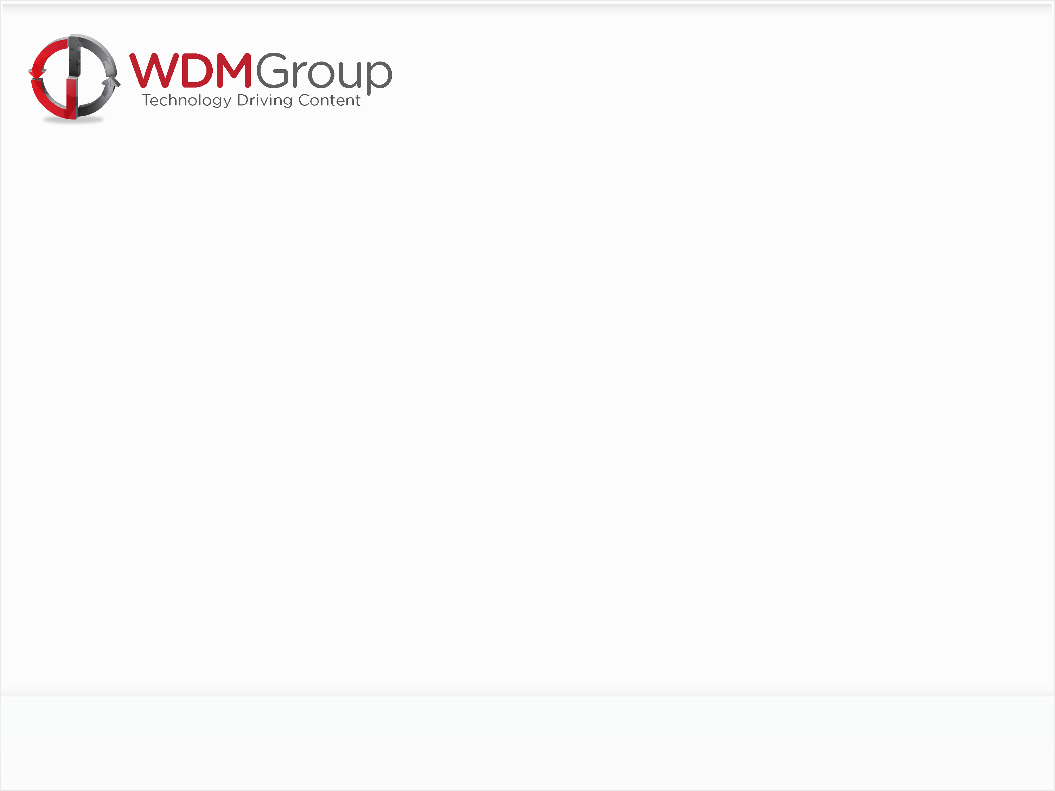
James Pepper Group Training & Development Manager Email: james.pepper@wdmgroup.com Direct Line: 0044 (0)1603 217544 Fax: 0044 (0)1603 617082
View all of our products at our corporate site: WDM Group www.wdmgroup.com
112-114 Grosvenor | Prince of Wales Road | Norwich | NR1 1NS

